Slide 1
Autonomous Car
Neural networks and deep learning
Group：Ramil, Weiwei, Yuyang

Slide 2
Outline
Platform Choice
Codes Review
Demonstration
Improvement Direction

Slide 3
Platform Choice

Slide 4
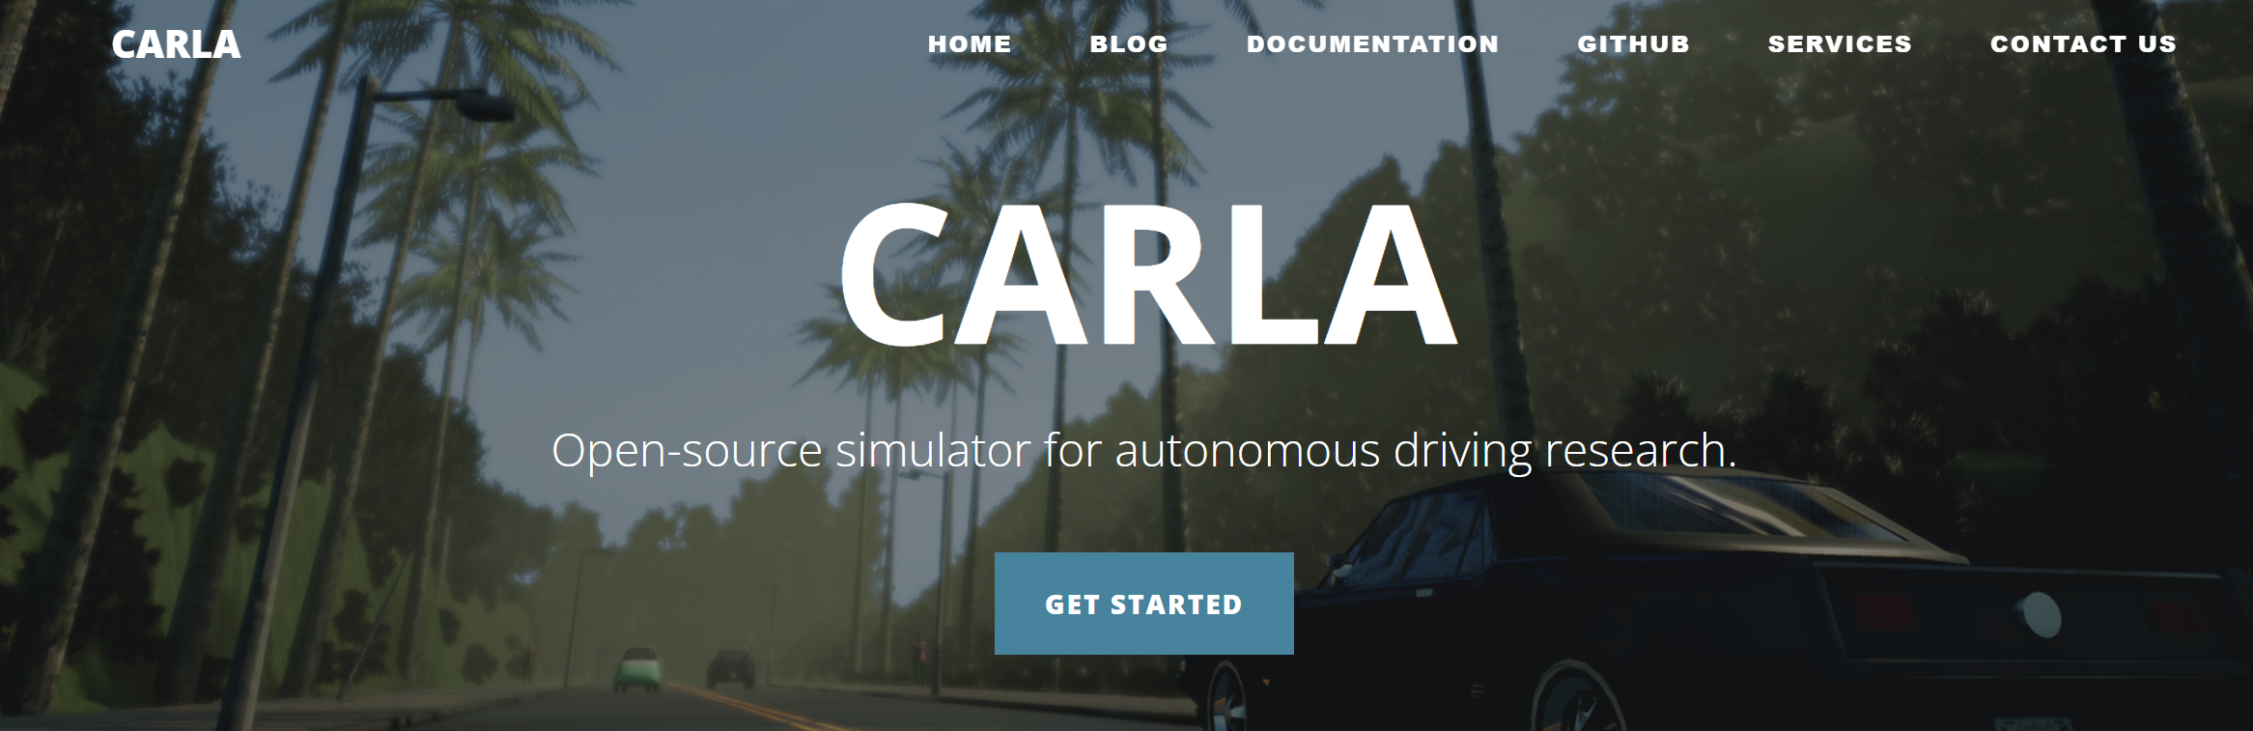
Carla-- An open-source autonomous driving simulator, ideal for in-depth research
Advantages
High-fidelity simulation with Unreal Engine for realistic physics and environments
Comprehensive sensor support including RGB cameras, LiDAR, and GPS
Flexible API interface with ROS integration for customization
Disadvantages
Complex installation process, challenging for beginners
Requires high-performance hardware
Requires significant computational resources for optimal performance
At least 20 GB of RAM

Slide 5
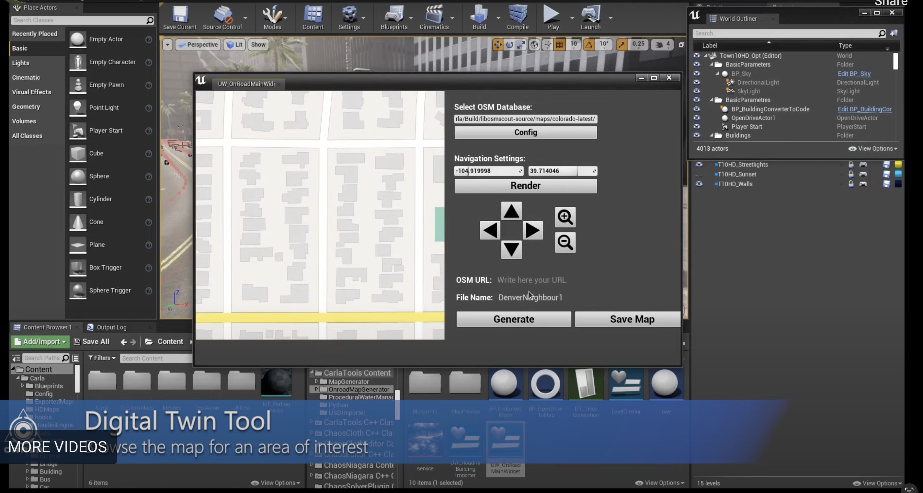
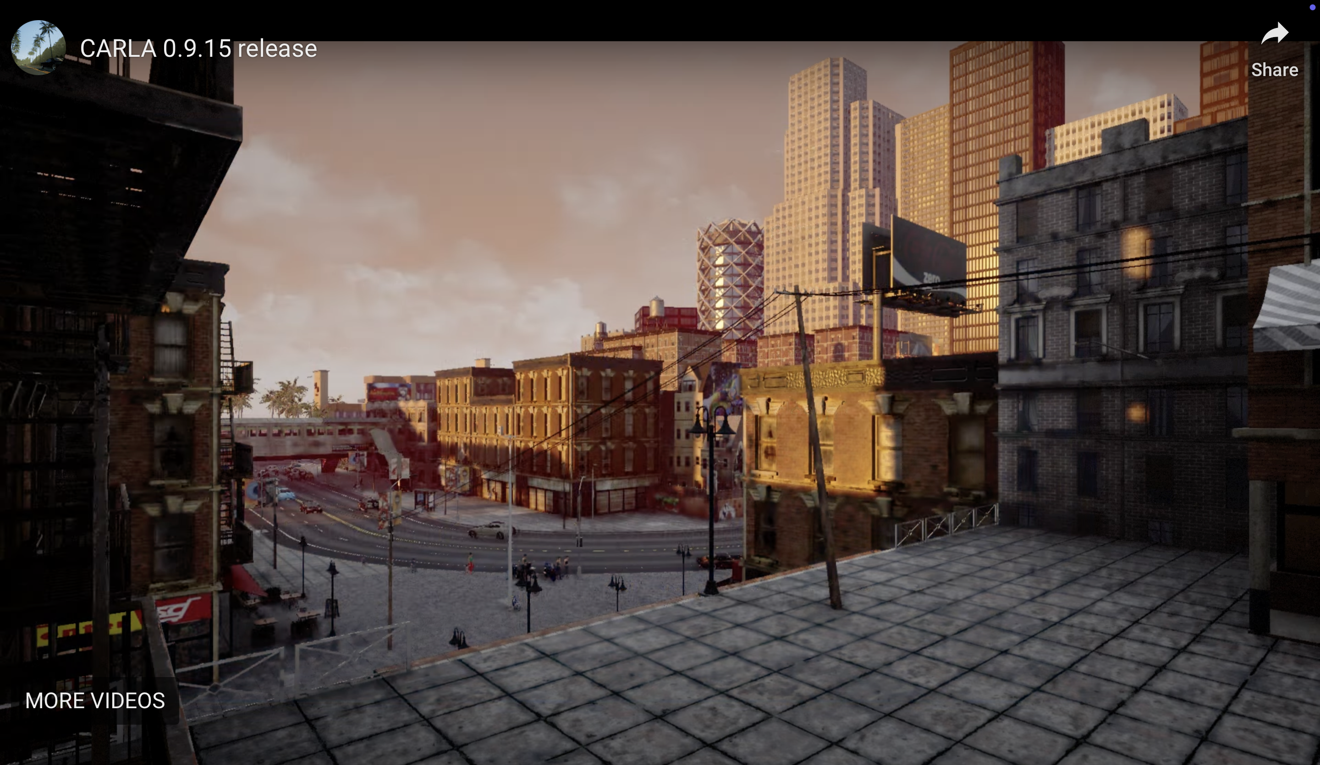
Industry professional standard engine, not suitable for school project
Based on Unreal Engine 4, a professional game development environment

Slide 6

Udacity-- A lightweight educational tool
Advantages
Easy to install and use
Lightweight and has low hardware requirements, suitable for most computers.
Designed for educational purposes, with simple environments that focus on core principles like lane keeping and trajectory planning.
Disadvantages
The simulator offers fewer scenarios and its dynamics modeling is relatively simple, making it less suitable for complex autonomous driving research.
May experience instability, especially on Ubuntu systems, potentially affecting user experience.
Update 6 years ago

Slide 7
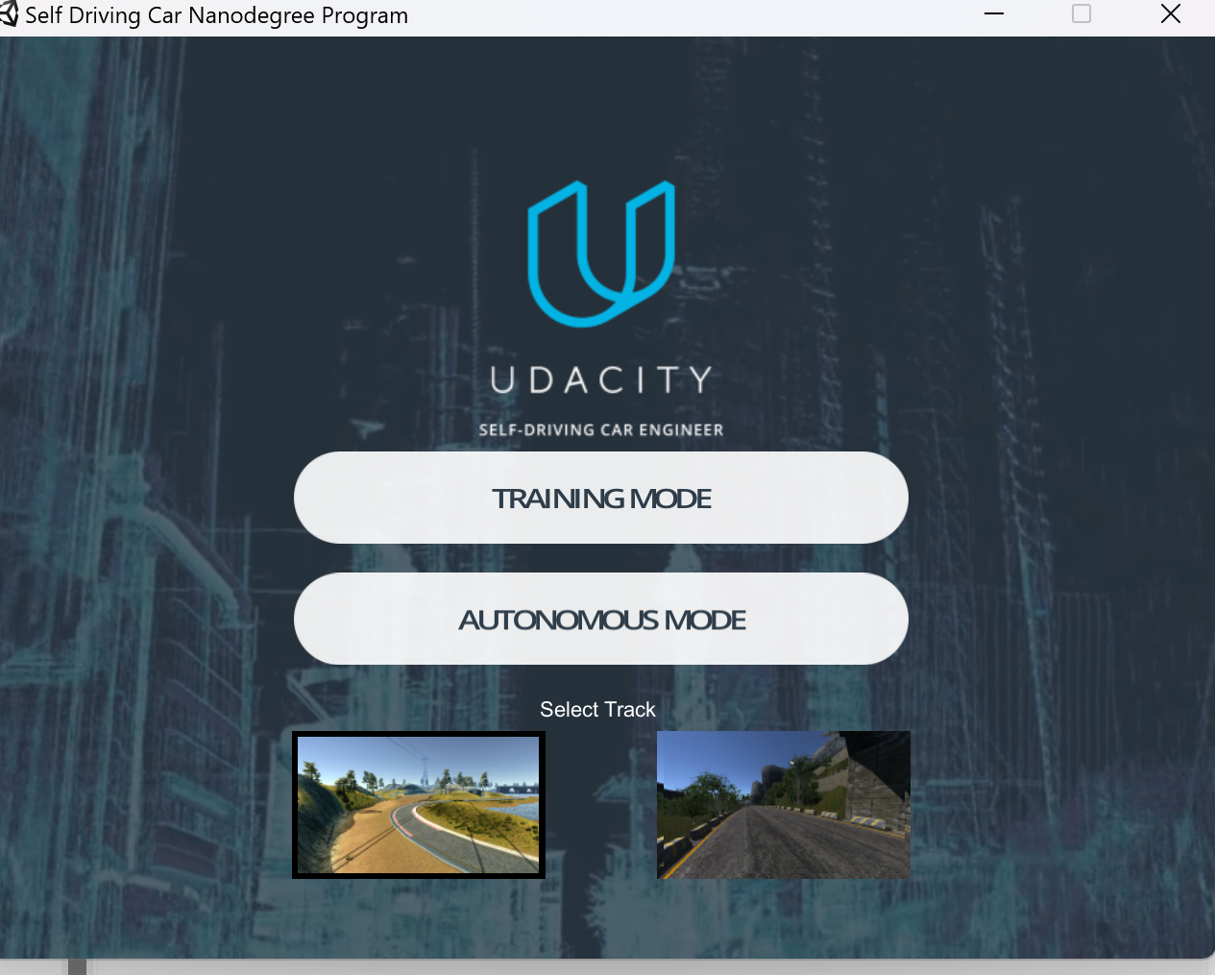
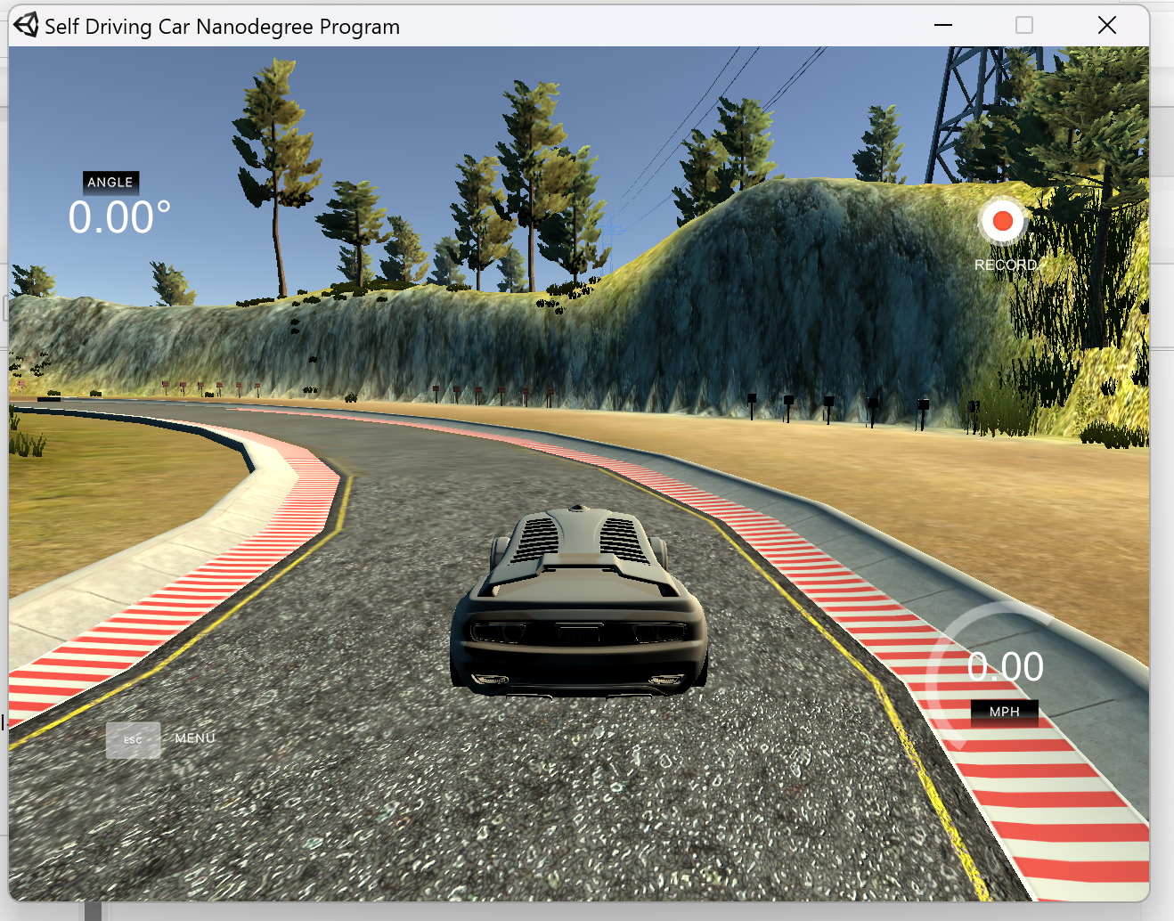

Slide 8
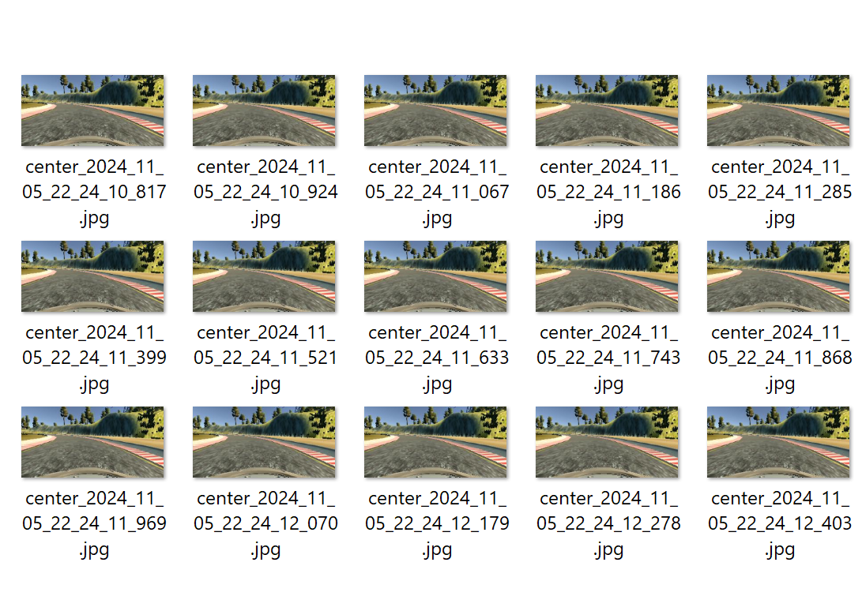

Slide 9
Codes

Slide 10
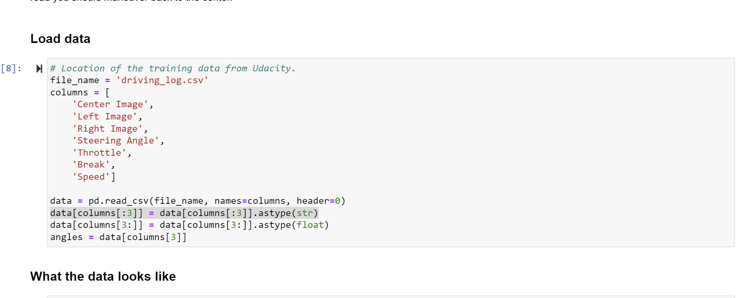
Load data

Slide 11
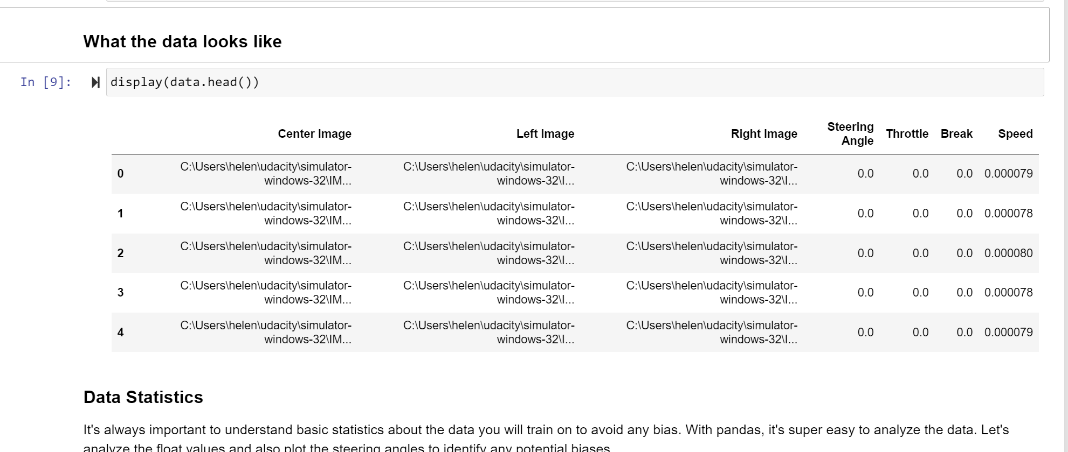
Data pre-processing

Slide 12
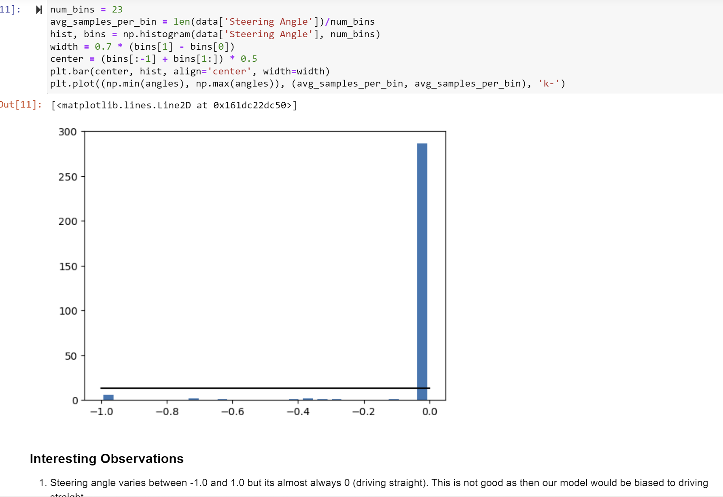
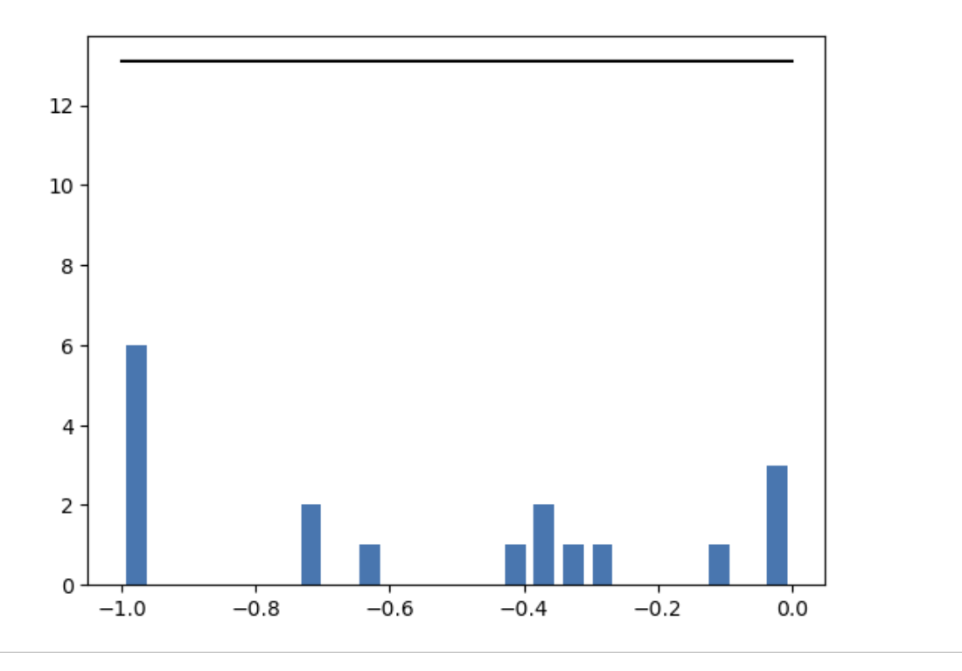
Down-sampling

Slide 13
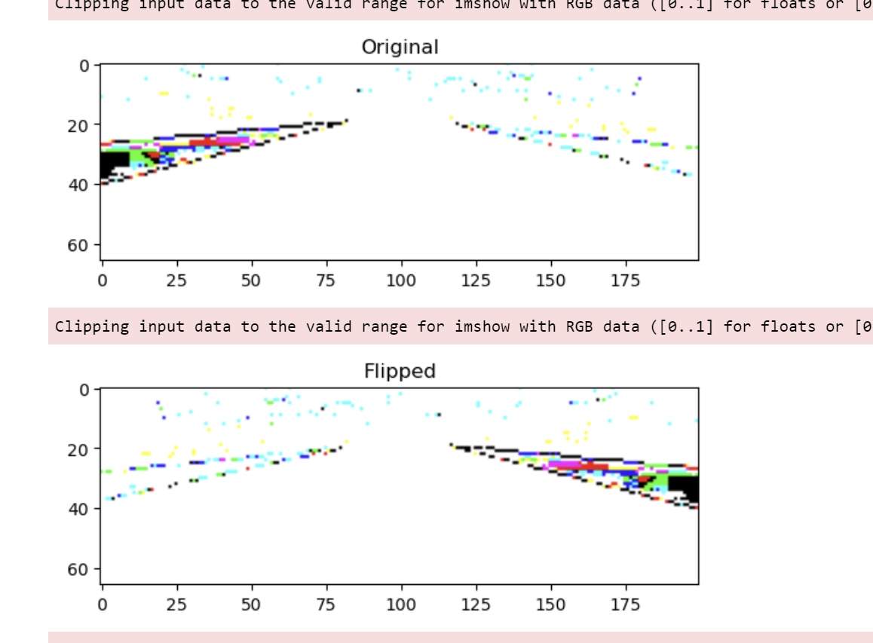
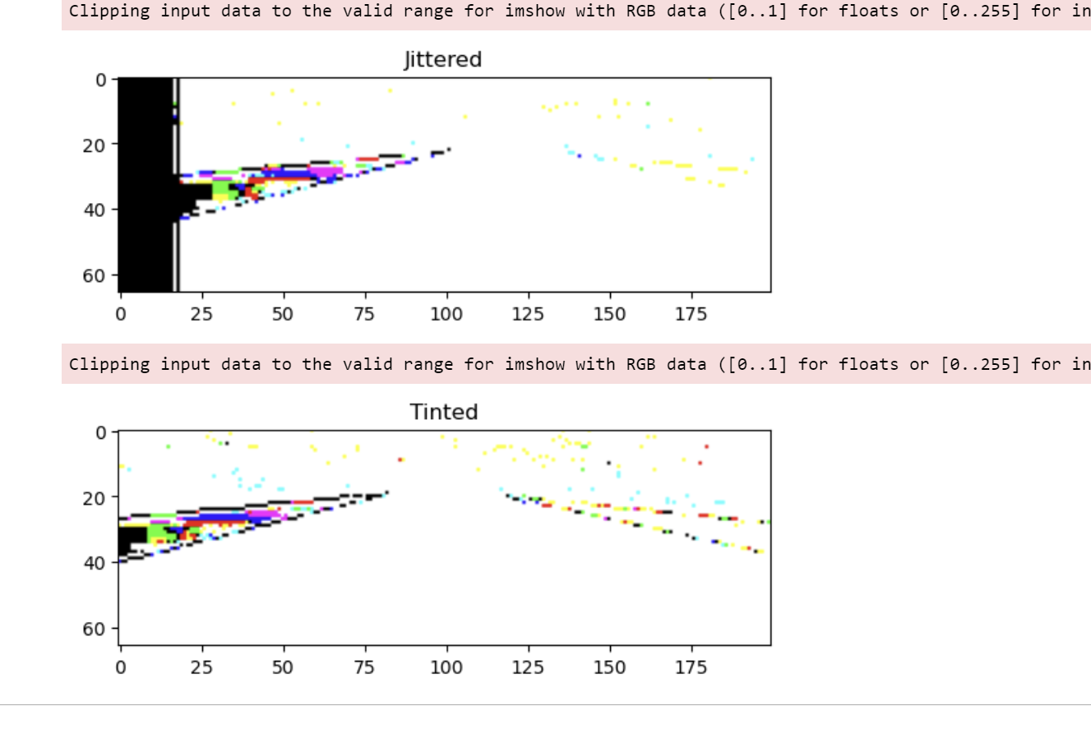
Data Augmentation – Flip, Jitter, Tint, Resize

Slide 14
Generate Training Data
Core function:
Define a batch generator.
Purpose: The batch_generator function creates a generator that yields batches of image data and corresponding steering angles. This is useful for efficiently training a neural network model by providing data in chunks (batches), especially when dealing with large datasets.

Slide 15
Parameters
1. images: A DataFrame containing paths to images (center, left, and right camera views of a car).
2. angles: A Series containing steering angles corresponding to the center images.
3. batch_size: Number of samples to include in each batch. Default is 64.
4. augment_data: A boolean indicating whether to augment the data (e.g., by flipping images).

Slide 16
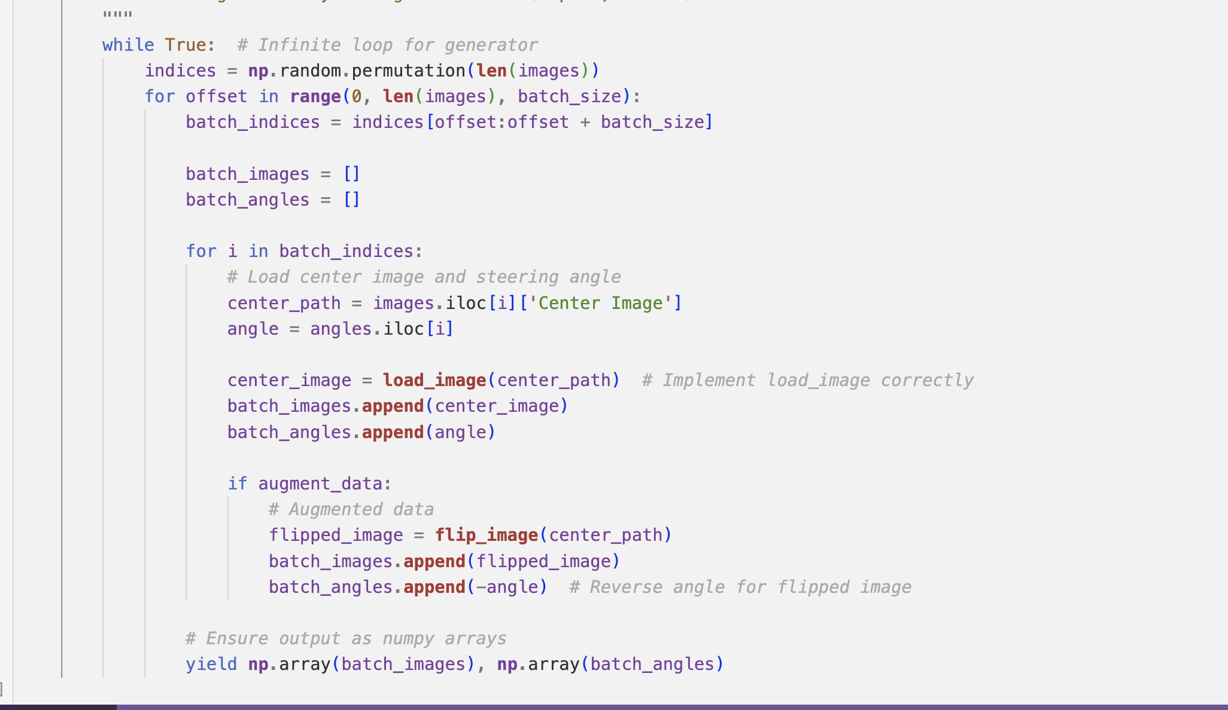

Slide 17
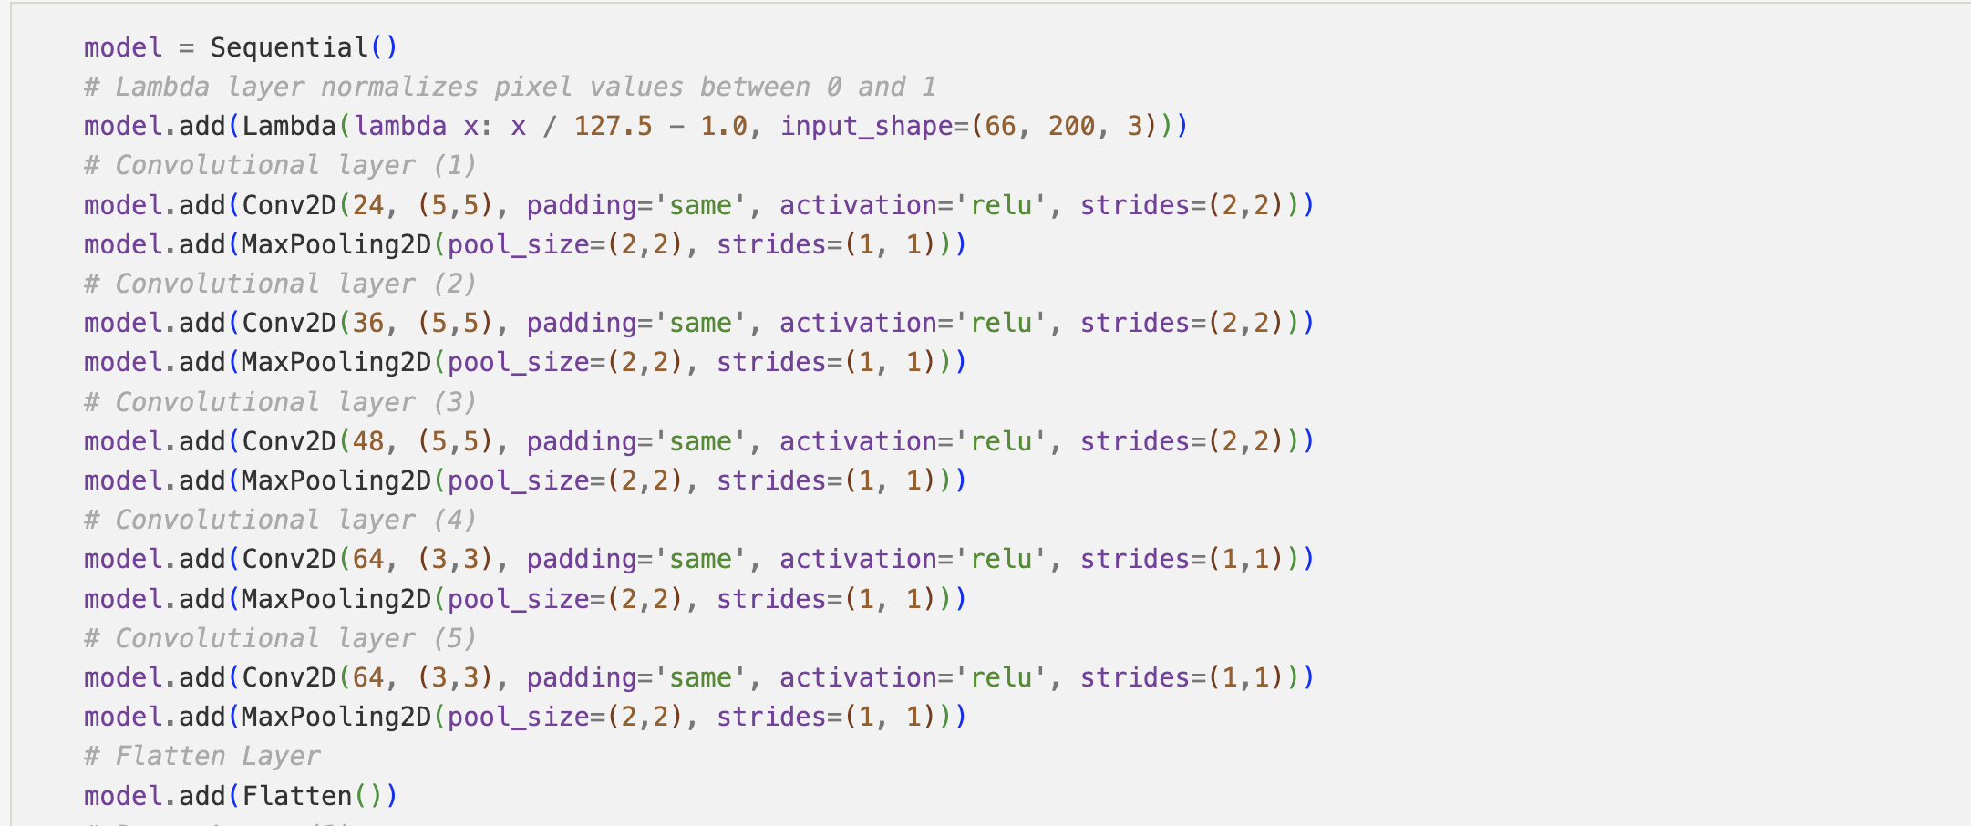
Build the Model
Model is based on NVIDIA's "End to End Learning for Self-Driving Cars" paper [End-to-End Deep Learning for Self-Driving Cars](https://images.nvidia.com/content/tegra/automotive/images/2016/solutions/pdf/end-to-end-dl-using-px.pdf)

Slide 18
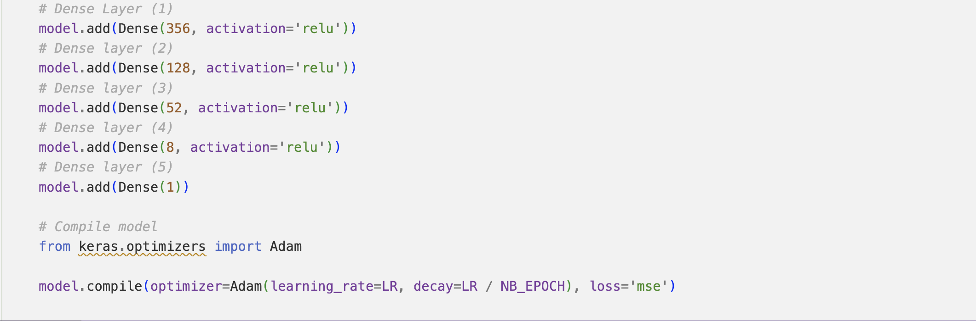

Slide 19
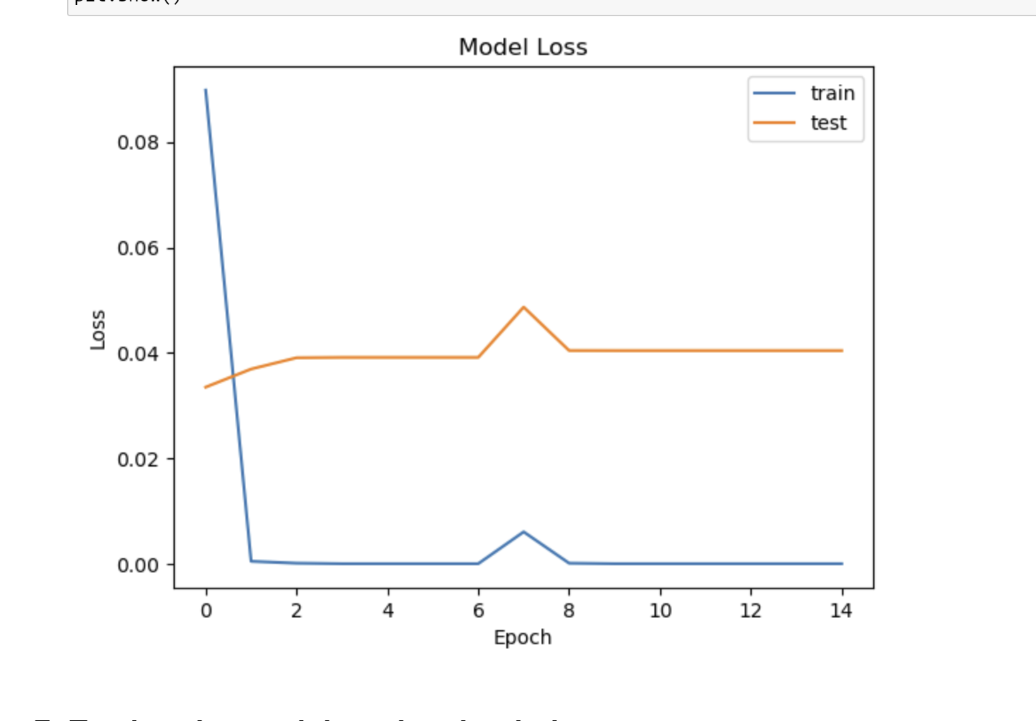
• There’s a clear gap between training and validation loss. The training loss is near zero, but the validation loss stays relatively high and flat. However, the gap is not big.

Slide 20
Reference
Video:
https://www.instructables.com/Self-Driving-Car-With-Udacity-Simulator/
https://www.youtube.com/watch?v=iutOIJt1zVM
GitHub:
GitHub - naokishibuya/car-behavioral-cloning: Built and trained a convolutional network for end-to-end driving in a simulator using Tensorflow and Keras
udacity/CarND-Behavioral-Cloning-P3: Starting files for the Udacity CarND Behavioral Cloning Project
ndrplz/self-driving-car: Udacity Self-Driving Car Engineer Nanodegree projects.
GitHub - asujaykk/Self-Driving-car: This project demonstrate basic self driving car model using udacity car driving simulator
Websites:
Hacktorial #1: Building a Self-Driving Car with Deep Learning | by Sujith Vishwajith | Decode Ways | Medium

Slide 21

Reflection
Worked with convolutional neural networks (CNNs) to process camera input for behavior cloning.
Understood the importance of data preprocessing, such as cropping, resizing, and normalizing images.
Spent a lot of time on adjusting simulators.
Need more time to do the reasearch and learning.
Take classes in Udacity Plateform

